Slide 1

Ticket Complete & Pending Guide Desktop version
Triage Team

Slide 2
Flowchart
Flowchart Reviewed by: Albert Shin
Technician selects ‘COMPLETED’ on ER Mobile
or
Technician updates Visit Log status to ‘READY TO COMPLETE’
Technician finishes the Repair Job
Ticket is now marked as:
READY TO COMPLETE
Immediately, the Ticket status gets Automatically updated to COMPLETED
If Ticket age is 9 days or more
If Ticket age is less than 9 days
Ticket remains marked as ‘READY TO COMPLETE’ until Aging reaches 8 days
Ticket status gets Automatically updated to COMPLETED the morning of the 9th day
*IMPORTANT: Not all Tickets will successfully be Completed automatically. Inquiry will make a record if the Auto Complete fails. Managers MUST review Failed Auto Complete tickets and manually Complete those tickets every morning. You can check Failed Auto Complete Tickets by going to ER > Ticket > Follow-Up Dashboard OR, on Ticket list, search by Repair Status.

Slide 3

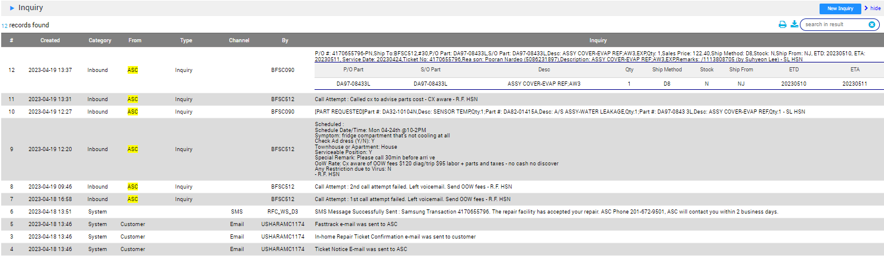

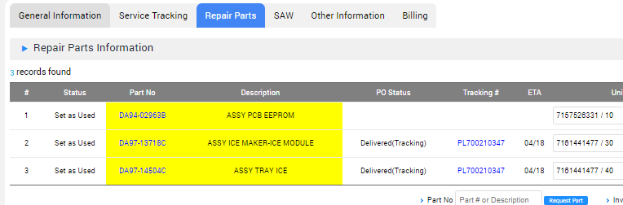

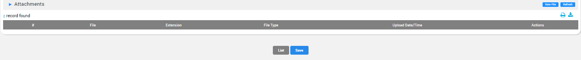
1. Ticket Complete
Please Check the information below before completing the ticket!
Step to check “Inquiry” (Ticket > Service Tracking > Inquiry )
*Make sure to input the proper documentation on the inquiry!
Step to check “Repair Parts” (Ticket > Repair Parts > Repair Parts Info)
*Check part status, delete not used parts, and leave the used parts!
Proper notes including Part #, Invoice #, Unique ID needed
Step to check “Attachments” (Ticket > Other Information > Attachments)
*Make sure proper pictures are uploaded!

Slide 4
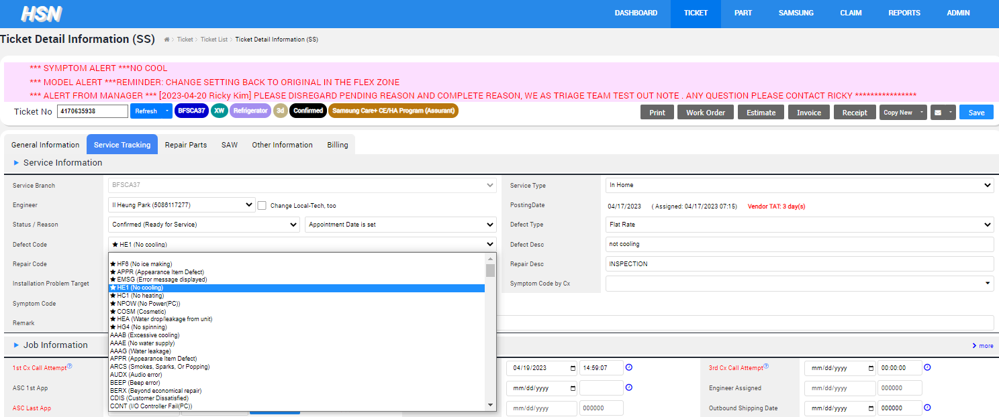

1. Ticket Complete
Input “Defect code” (⭐ : most common reason used by technicians)
Input “Defect description”

Slide 5
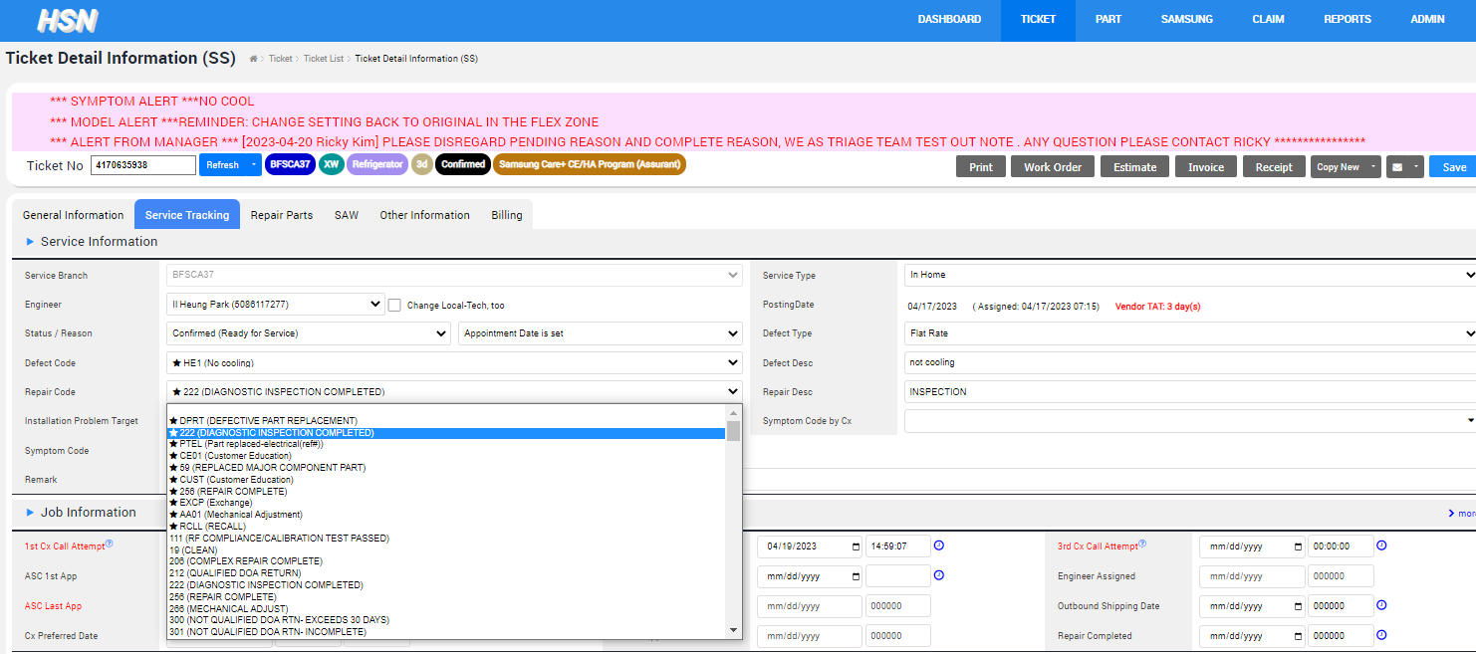
1. Ticket Complete
Input “Repair code” (⭐ : most common reason used by technicians)
Input “Repair description”

Slide 6
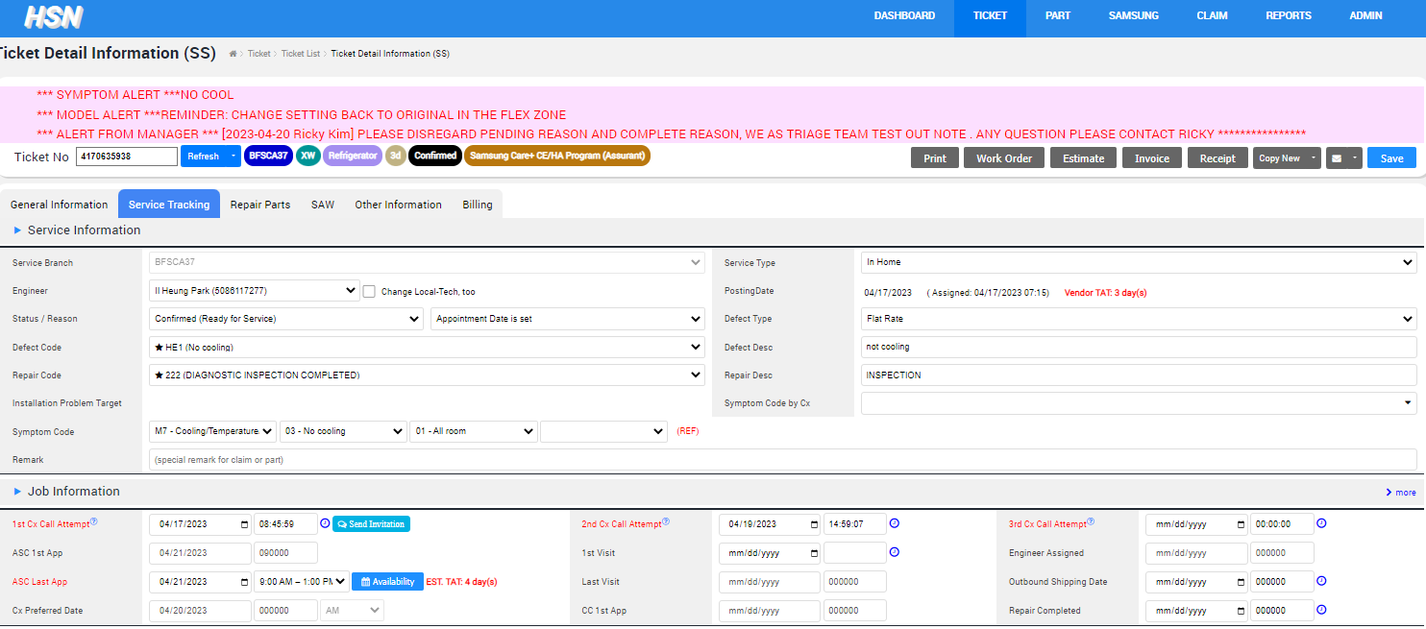


1. Ticket Complete
Click icon next to “Repair Completed” to update time!

Slide 7
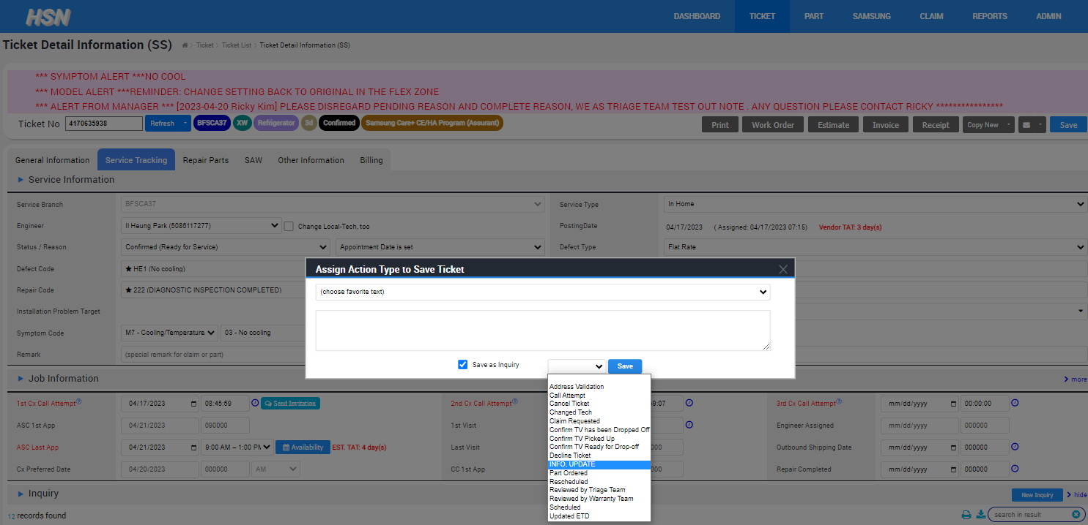
1. Ticket Complete
Click “Save” on the top right section
Set Inquiry as “Info update”
Click “Save” in the box!

Slide 8
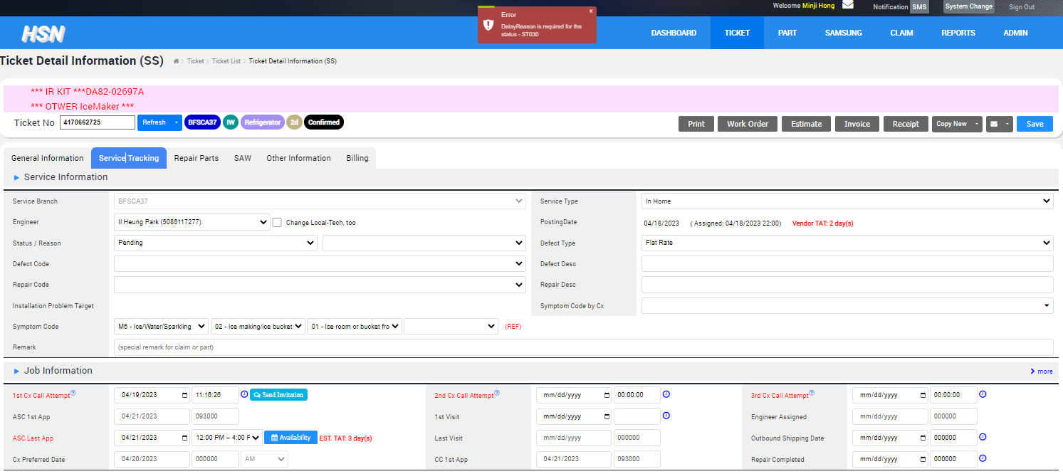
1. Ticket Complete
If there’s any error code while trying to complete it,
Leave Ticket status as “Pending”
Input Reason as “ Waiting for warranty documents (POP/BOS)”

Slide 9
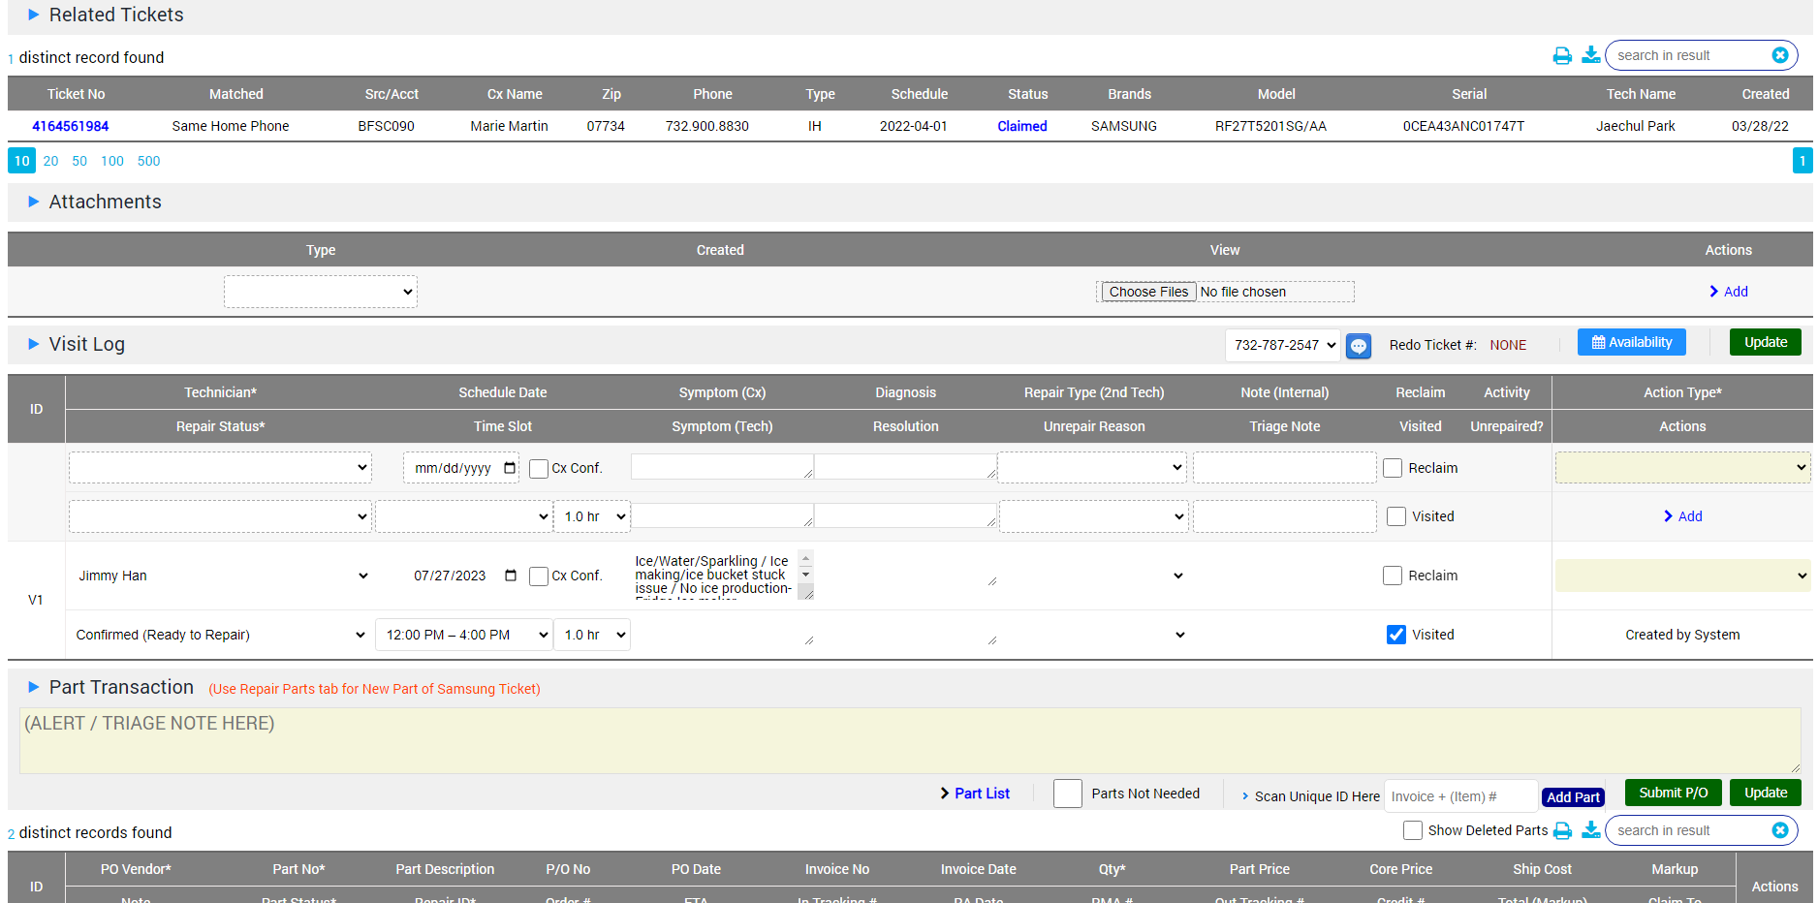
How to Complete (ER Desktop)
Once you are done with the Repair and you are finished with uploading files and making notes, you will need to set the ticket to ‘READY TO COMPLETE’
1. Located under the ‘Service Tracking’ tab, scroll down to ‘Visit Log’

Slide 10
How to Complete (ER Desktop)
Once you are done with the Repair and you are finished with uploading files and making notes, you will need to set the ticket to ‘READY TO COMPLETE’
1. Located under the ‘Service Tracking’ tab, scroll down to ‘Visit Log’

Slide 11
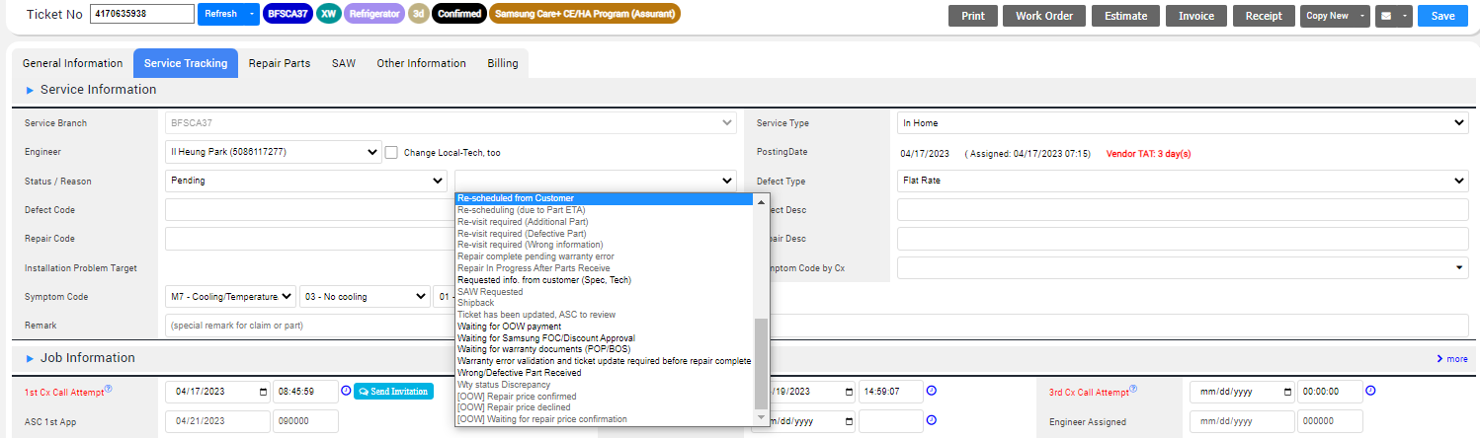
2. Ticket Pending
Input Status as “Pending”
If tech has to go back to Cx, Input the reason as “Re-scheduled from Customer”
If tech can’t complete the ticket, Input the reason as
“ Waiting for warranty documents (POP/BOS)”
*** We only use 2 Pending reason ! ***

